Slide 1
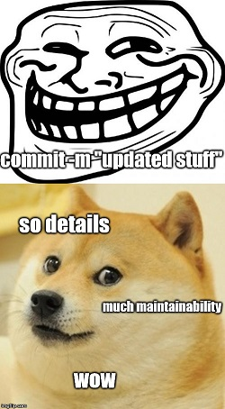
GitHub
Using GitHub for Knowledge and Project Management
David Alt, MD, FAAP
October 2018

Slide 2
What is GitHub?
Git is an opensource Distributed Version Control System
Every repository (even local working copies) contain a complete record of changes
The repository stores content differences and relationships
You can completely restore an earlier version, without overwriting the newer ones
Git is fast, secure, and widely supported
GitHub is an online service that hosts git repositories
With each repository, GitHub provides ...
issue trackers
project management tools (Kanban)
documentation tools (wiki)
Repositories can be private or public

Slide 3
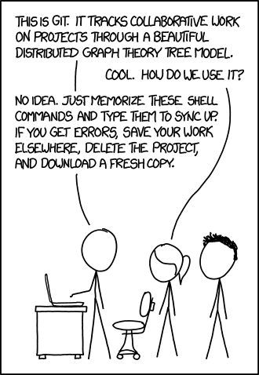
How does git work?

Slide 4
How does git work?
1) You clone the remote (hosted) repository to create a local copy
2) Make changes to the local files
3) Commit those changes to the local repository
4) Push your changes to the remote repository
If someone else changed the same files as you at the same time, git will show you the differences and help you merge them.
... but a smart user will fetch or pull to update the local copy before updating the main repo
You fork someone else’s repo if you want an independent copy
You create a branch if you want to work on a feature without interfering with the rest of the repository

Slide 5
GitHub
Although originally designed for software development, GitHub can be leveraged for low-level project and knowledge management
Pros:
cheap for small groups (free for us as academic researchers)
minimal barrier entry (if not using a git workflow)
accessible from government computers
MarkDown!
Cons:
project management tools not suitable for actual enterprise project management
less cheap if the rest of the department wanted to join us
not everyone is excited about MarkDown

Slide 6
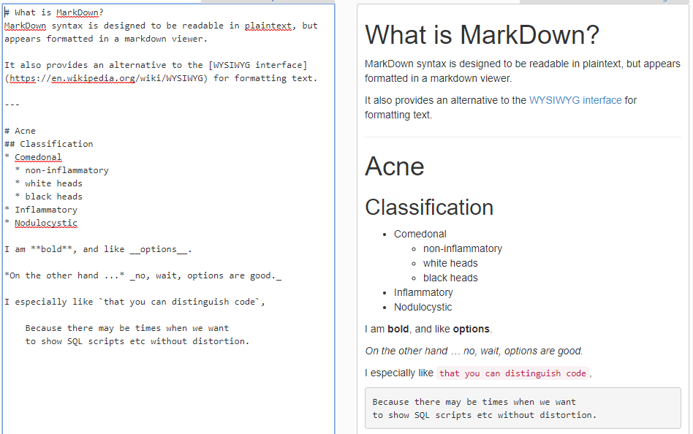
What is MarkDown?

Slide 7
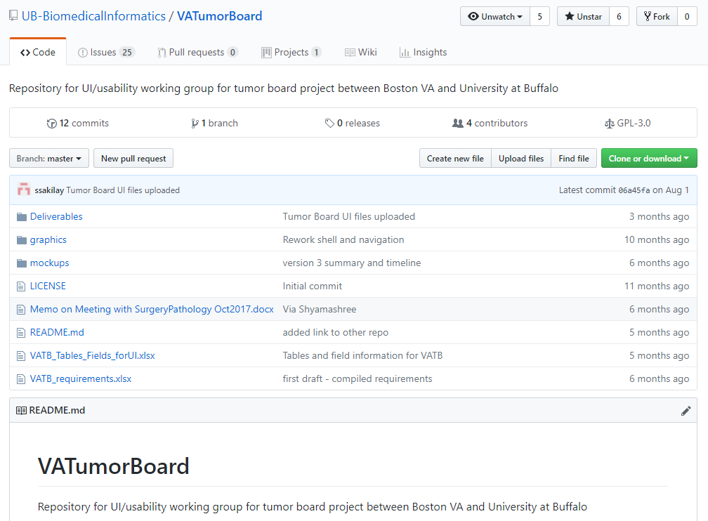
Project Demo: VA Virtual Tumor Board
Civilian-VA collaborative project with 4 working groups in 2 states.
Main page displays file repository and introductory page.

Slide 8
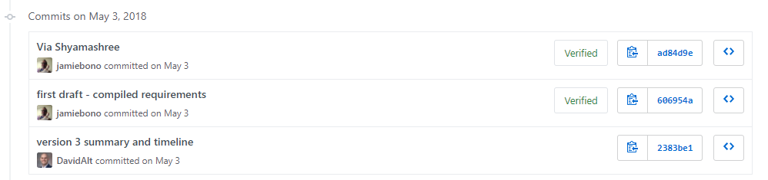
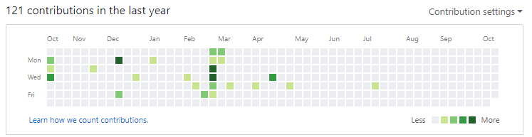
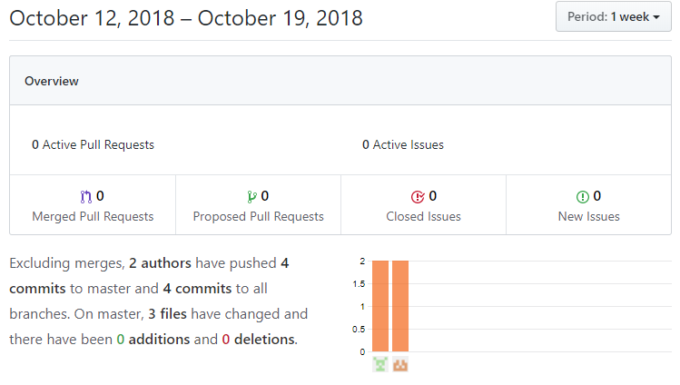
Project Demo: VA Virtual Tumor Board
Commit History
Record of every change to the repository
You can also access analytics (“Insights”) to see exactly who is slacking.

Slide 9
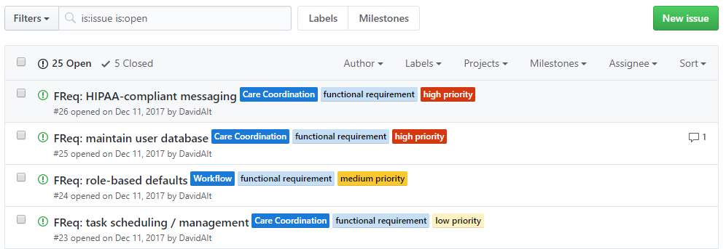
Project Demo: VA Virtual Tumor Board
Tracking Functional Requirements With Issues
This turned functional requirements into discrete, trackable issues that could independently track progress and maintain separate documentation.

Slide 10
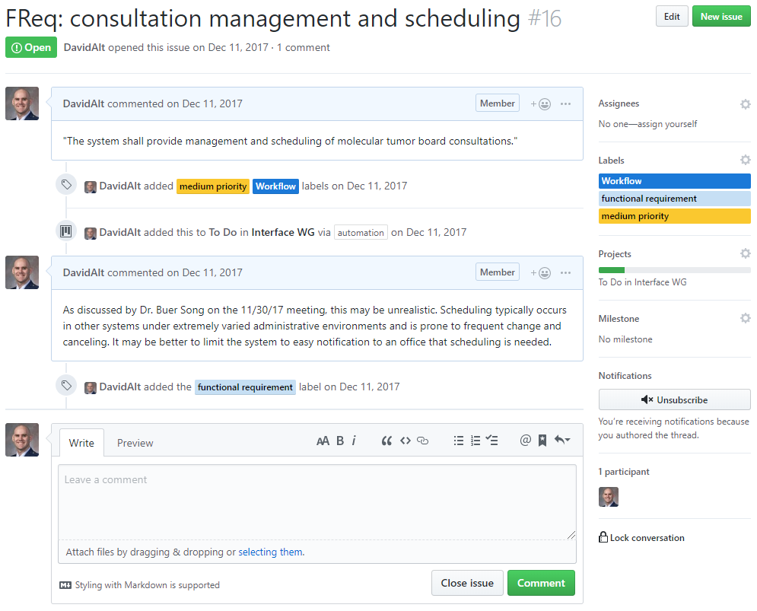
Project Demo: VA Virtual Tumor Board
Functional Req As Issue
Issues can be color-coded, tagged, assigned to members, projects, or milestones, and can issue email notifications when changed.
Comments support rich content and MarkDown!

Slide 11
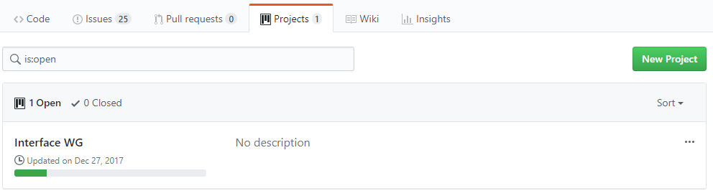
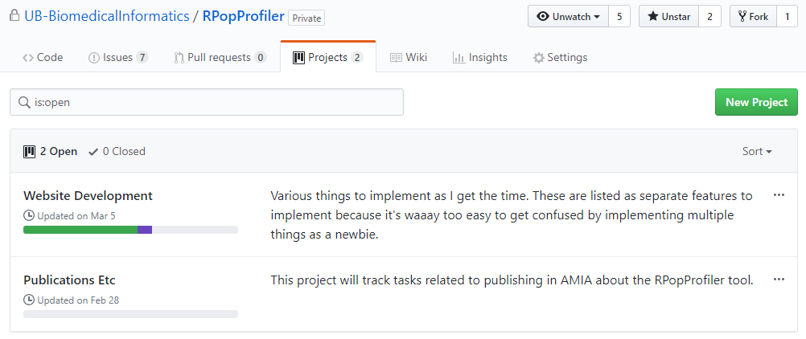
Project Demo: VA Virtual Tumor Board
Projects
Projects are used for Kanban boards.
Projects belong to the repository, not the other way around.
A repository can have multiple projects.

Slide 12
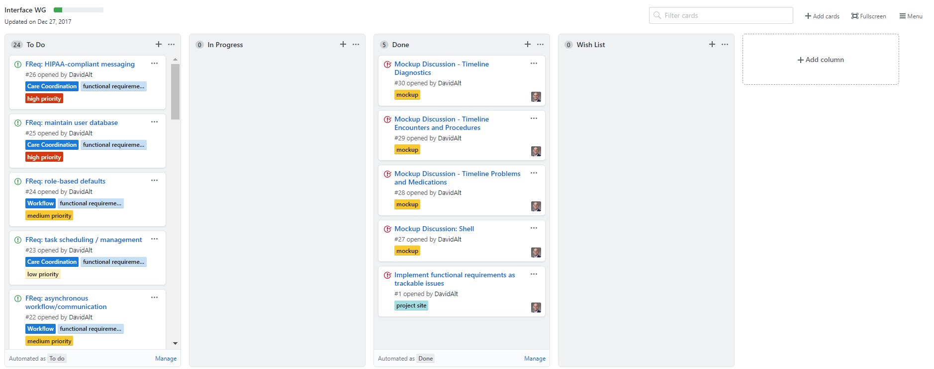
Project Demo: VA Virtual Tumor Board
Project Kanban Board
Projects (Kanban)
Projects are used for Kanban boards
Projects belong to the repository, not the other way around
A repository can have multiple projects

Slide 13
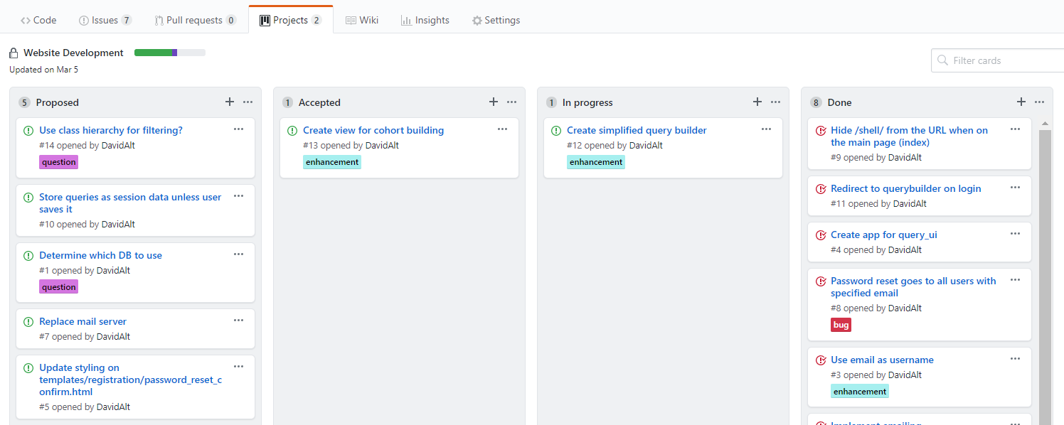
Project Demo: VA Virtual Tumor Board
Project Kanban Board – Choose Your Own Column Headings!
Projects (Kanban)
Projects are used for Kanban boards
Projects belong to the repository, not the other way around
A repository can have multiple projects

Slide 14
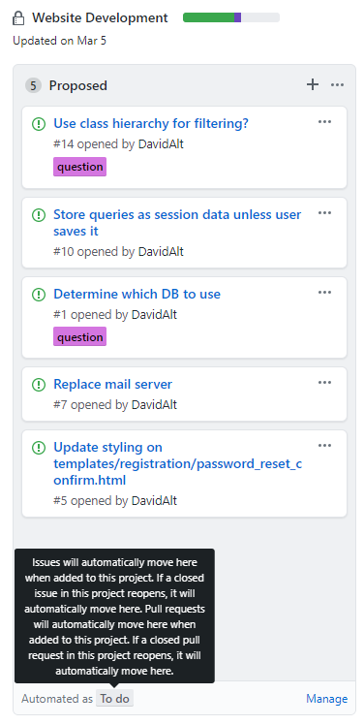
Project Demo: VA Virtual Tumor Board
Project Kanban Board – Choose Your Own Column Headings!
You can open the actual issue by clicking on its task
Each issue is automatically numbered
Automating Tasks
Recall that issues can be assigned to projects ...
This allows new issues to be automatically added to a project’s Kanban board.
This way you can separate task management from the work of the task itself.

Slide 15
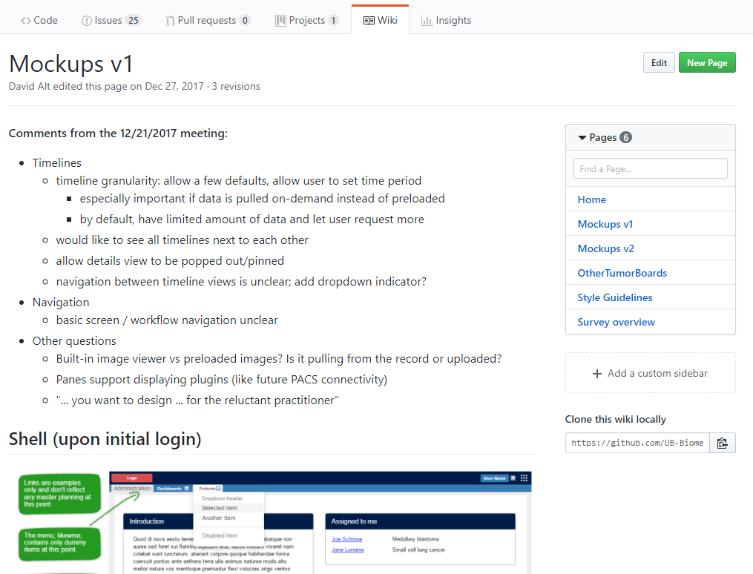
Project Demo: VA Virtual Tumor Board
Wiki
A repository can have many projects but only one wiki.
Images stored in the repository can be accessed.
You can also link directly to issues or other repo files.
Not as robust as Wikipedia but substantially easier to use.

Slide 16
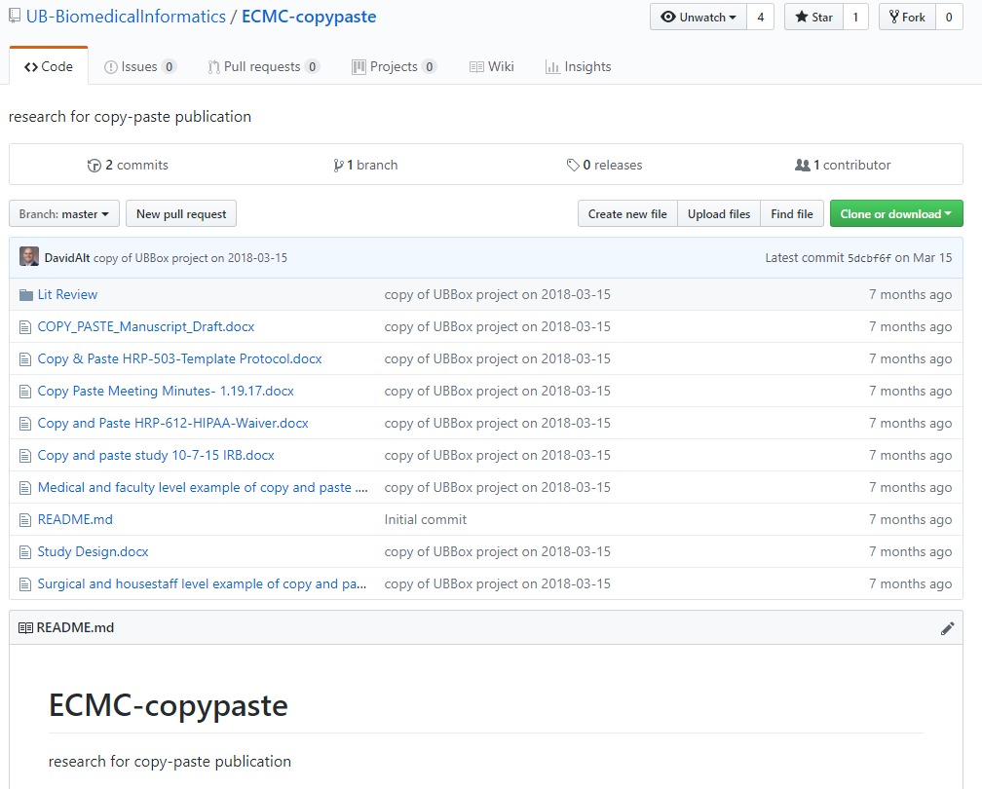
Fellow-Independent Longitudinal Access
Useful for projects that are handed off from fellow to fellow.
This copy-paste “publishing opportunity” has been languishing at Buffalo for at least three generations of fellows ... prior to this, it was fragmented across multiple Box accounts.

Slide 17
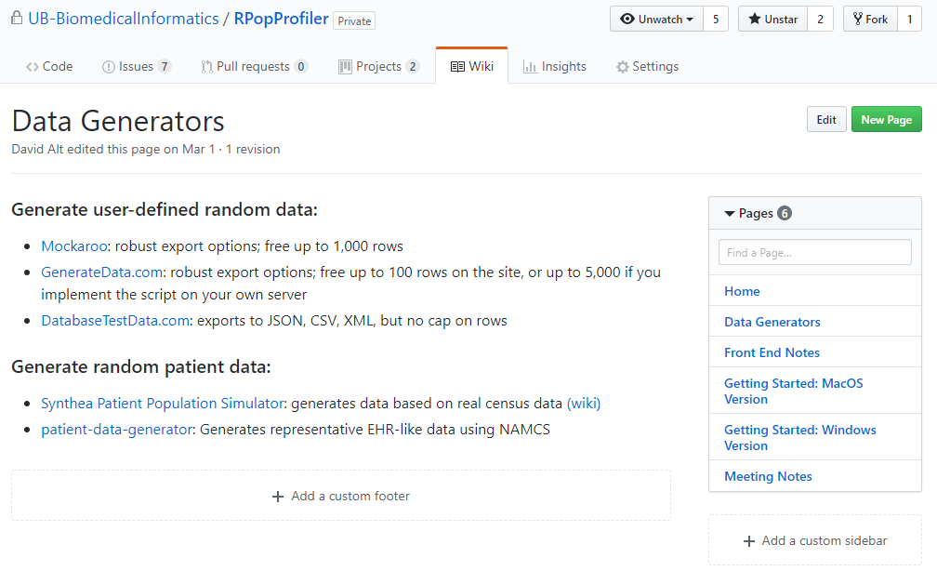
Knowledge Management
Every time one of us graduates, the program loses our collective knowledge.
A wiki could be a useful way to share our institutional knowledge and make it persistent.
How To’s, FAQs, POC lists,
UCERN documentation, useful links, etc

Slide 18
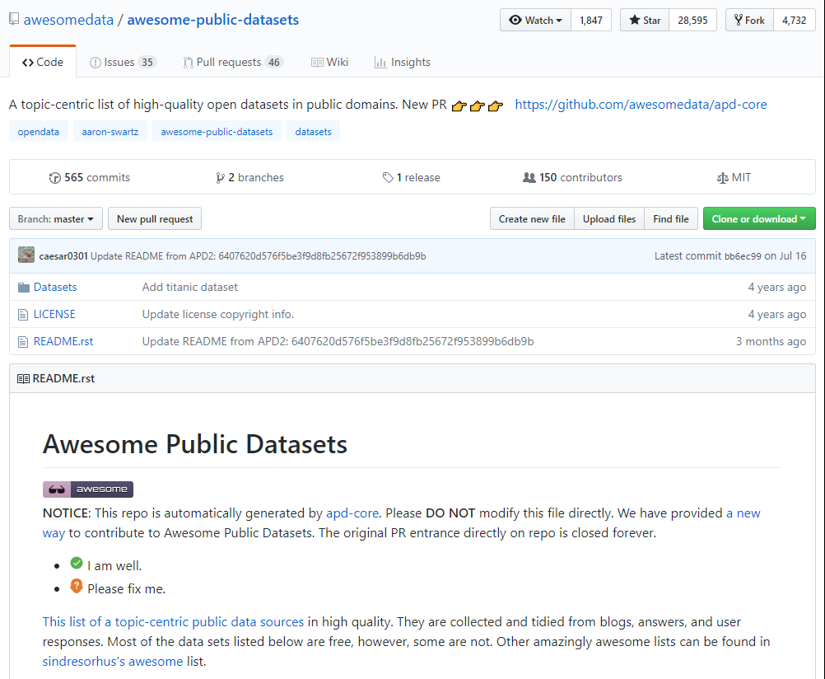
Repos As Curated Lists
Empty repository holding a curated list in the readme
Always displayed on the repository’s main page
Protected from casual edits
Updated by editing the readme markdown file
Others can suggest contributions by submitting issues

Slide 19
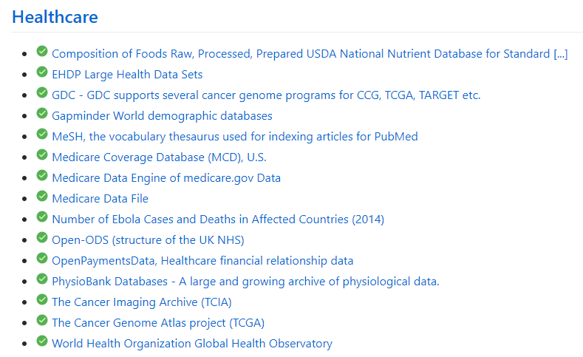

Repos As Curated Lists
There are multiple prominent informatics/big data lists that may be good resources for the fellowship.
You can “watch” or “star” these repos for updates.
Health Care section of the Awesome Big Data repo
(https://github.com/onurakpolat/awesome-bigdata)

Slide 20
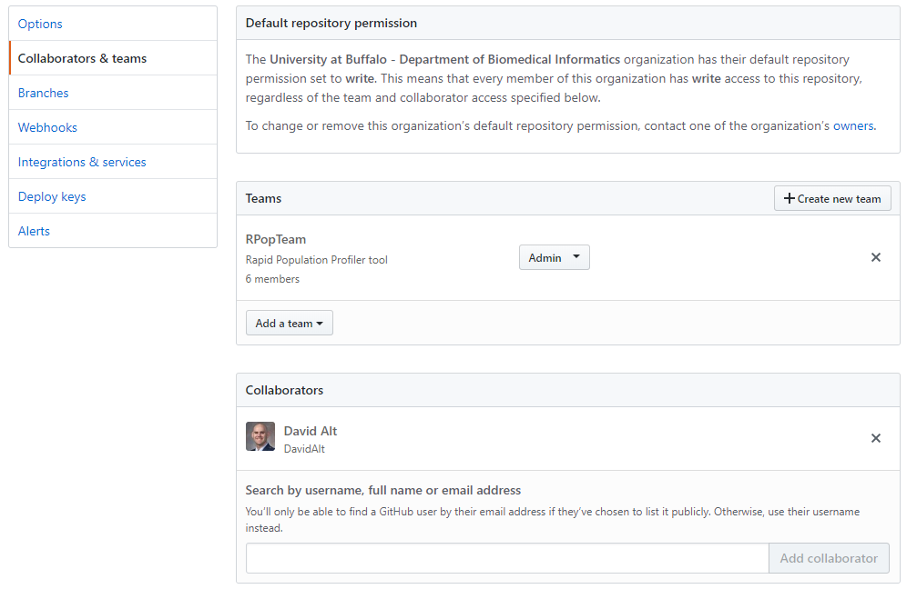
GitHub Organizational Account
Organizational accounts are different in that repositories are owned by the organizational account and administered by users.
You can group users into teams for additional collaborative features.
Collaborators can contribute to organizational projects, but must be invited.
Warning: Collaborators outside your organization DO count toward your “seat limit”!

Slide 21
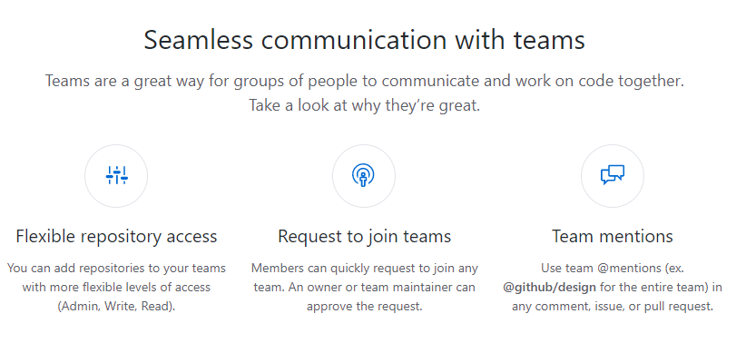
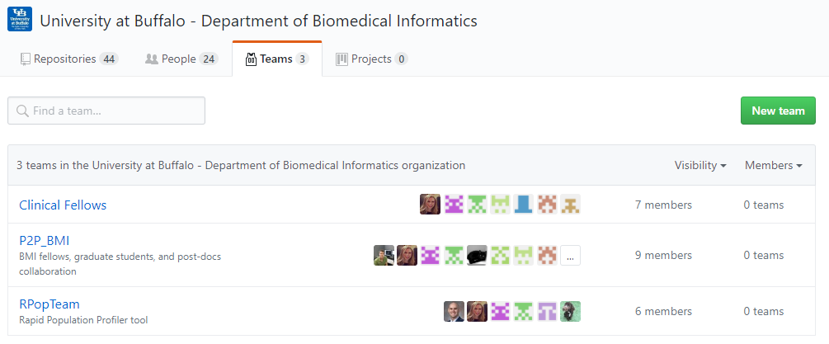
GitHub Organizational Account
Teams
The main benefit is organizational clarity and the additional communication features.
However, I haven’t personally used the discussion feature.

Slide 22
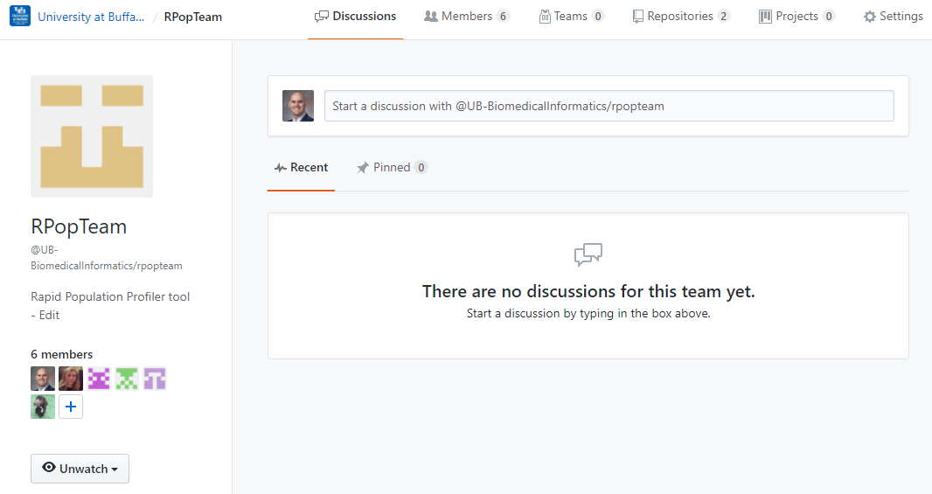
GitHub Organizational Account
Team Discussions
Seems to be a #hashtag-like feature, and can also be used in issues or uploads to alert the team.
I assume all uses of the tag are logged on the discussion page.

Slide 23
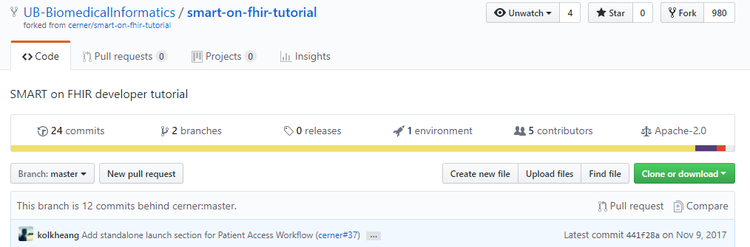
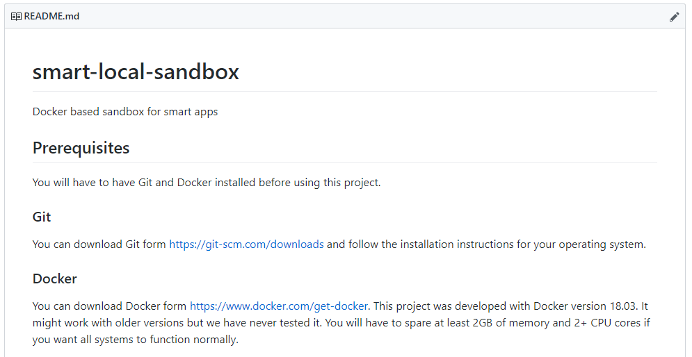
One Last Buffalo Example
Forking Interesting Repositories for Learning or Departmental Projects
UB forked Cerner’s smart-on-fhir tutorial and setup a local SMART sandbox in a Docker app.
This avoided the server issues plaguing the official sandboxes.

Slide 24
Conclusions
GitHub will help us ...
... coordinate our efforts
... organize and collaborate on projects
... build a library of informatics lectures
... pass on knowledge and projects to future fellows
Plus, we can access it from anywhere, even after we leave Madigan!

Slide 25

Questions?

